Slide 1

Industrial robots in harsh conditions
Kin Tung
Eren Pekgöz
Daniel Pedraglio O'Hara

Slide 2
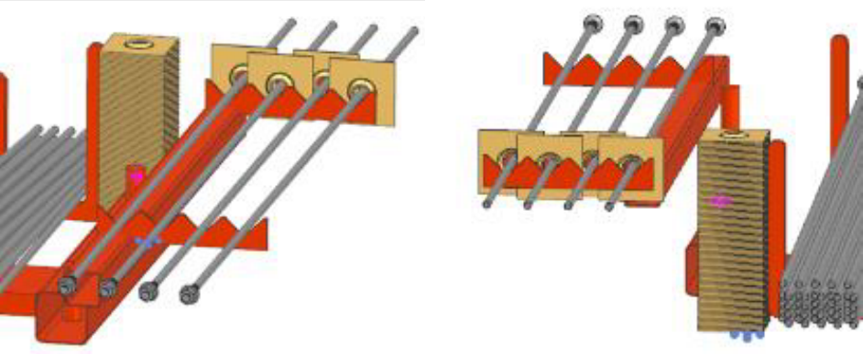
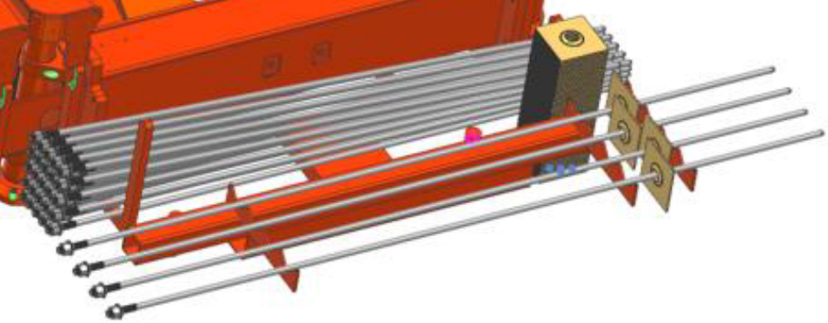
Introduction
Main goal:
Attach plates to rebars and set them on a tray.
Non-functional requirements:
The manipulator must work in unfavorable conditions like cold, darkness and moisture.

Slide 3
Goals
Applying the theory on an actual robot.
Managing a team in a robotics project.
Design robot to assemble rock bolts.

Slide 4
Tasks
Collect requirements with Sandvik
Design & build the tray
Design the manipulators
Program the robot arm
Design the protection of the machine for harsh conditions (Only concept)
Prepare simulations and demo

Slide 5
Resource allocation
Kin: Project manager and Gripper Design
Eren: Tray Reconfiguration and Electrical Design
Daniel: Robot System
Manhours:
8hrs per week per person

Slide 6
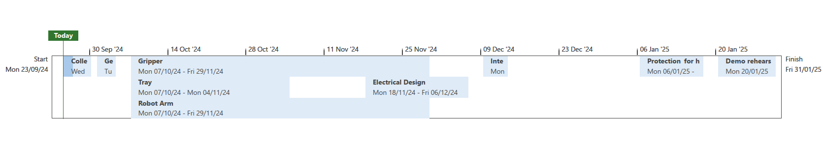
Timeline

Slide 7
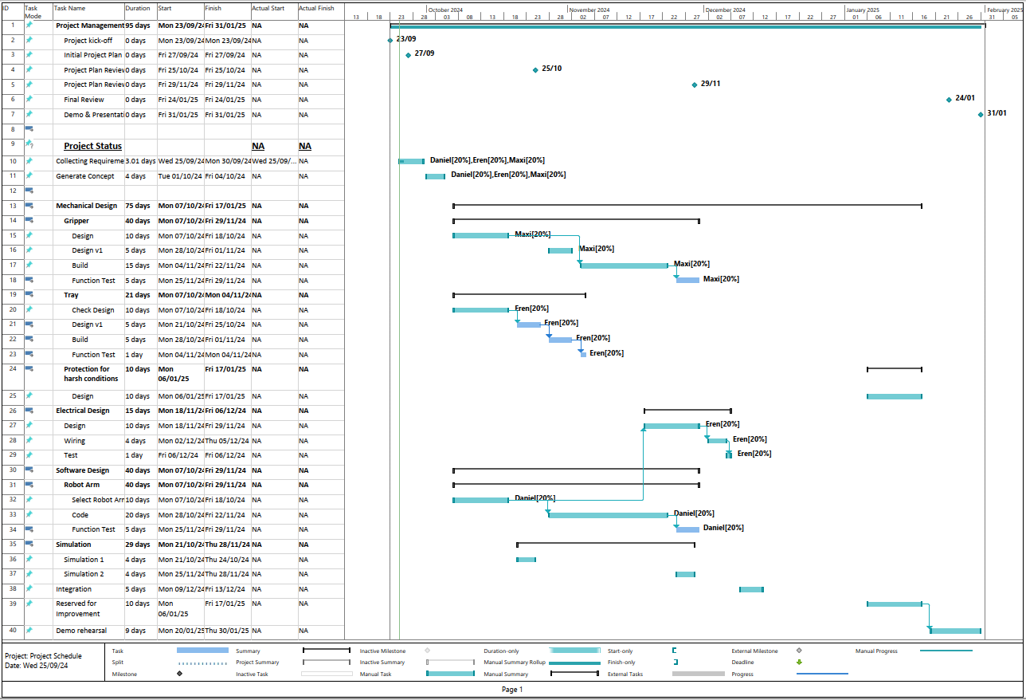

Slide 8
Risks
Risk | Severity | Probability | Mitigation
Uncertainty in requirements | 4 | 2 | Multiple meetings to discuss needs and present prototypes to clarify.
Missing components | 4 | 2 | Involve the coordinator in the meetings to consider available lab resources.
Scheduling problems | 3 | 2 | Plan meetings at least a week in advance.
Lack of expertise | 4 | 2 | More time will be allocated to tasks.
Insufficient budget | 5 | 3 | Coordinate with university. Simulation first.

Slide 9
SWOT
Strengths Different study backgrounds and work experience | Weaknesses All in the same master's degree Limited time
Opportunities Multiple robots available in the lab Collaboration with Sandvik | Threats Working at 1:5 scale may skew results Limited budget

Slide 10
Thank you!

